Slide 1
Group Project
Model Development:
KNN & Multiple Linear Regression
By Group 8

Slide 2





MEET OUR GROUP
Hoang Phuong Duy Nguyen
Rustam Adigozalov
Natarajan Govindarajan
Rajkumar Ramu
Henil Shah

Slide 3
INTRODUCTION TO THE MODELING SECTION
Purpose
To build and evaluate ML models (KNN & ML) to predict sentiment from restaurant review text.
Why This Matters
Text sentiment analysis is a core ML application in marketing & hospitality
Supports data-driven decision making (brand insights, customer experience)
Workflow Overview
Dataset → Preprocessing → TF-IDF → Scaling → PCA → Model Training → Evaluation

Slide 4
DATASET DESCRIPTION & CLEANING
Dataset Overview
  Yelp Open Dataset — restaurant reviews
  Features used: review text + star ratings
  Goal: convert ratings into binary sentiment
  Positive = 4–5 stars
  Negative = 1–2 stars
  Neutral (3 stars) removed
Benefit: Clean, consistent dataset → stronger model performance
Cleaning Performed
  Removed missing reviews and missing ratings
  Dropped duplicate entries
  Filtered out 3-star neutral reviews
  Created sentiment column (0 or 1)
  Kept only required fields for modeling
  Normalized review text:
  lowercasing
  removing punctuation & non-alphabetic characters

Slide 5
FEATURE ENGINEERING & PREPROCESSING
Objective
Prepare the text reviews so machine learning models can understand them by converting text into numerical features and reducing complexity.
Methods Used
  TF-IDF: Converted cleaned text into 3,000 numerical features
  Train–Test Split (80/20)
  Scaling (StandardScaler): Fit on train → transform on validation
  PCA: Reduced 3,000 features to 100 components

Slide 6
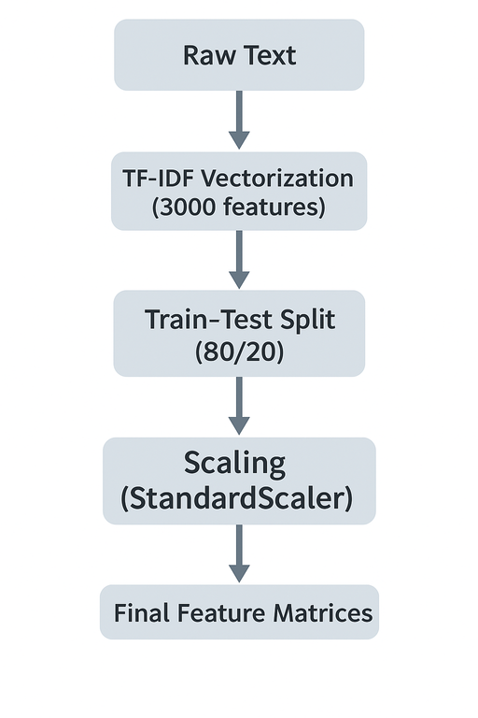
FEATURE ENGINEERING & PREPROCESSING
Workflow Diagram
Why These Steps Matter
  TF-IDF turns reviews into numerical meaning
  Scaling prevents large features from dominating
  PCA speeds up training & removes noise
  These steps create standardized, noise-reduced inputs for more accurate models
Output
  train_X_pca (34,976 × 100)
  valid_X_pca (8,744 × 100)
  Clean, structured data ready for model training
  Final processed dataset used by all downstream models

Slide 7
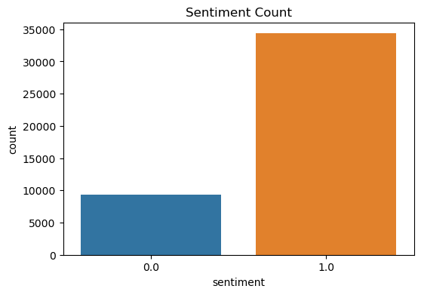
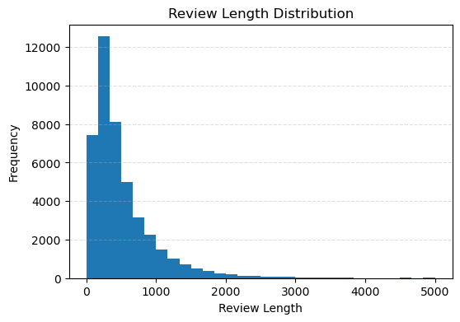
EXPLORATORY DATA ANALYSIS (EDA)
Sentiment Distribution
  Sentiment classes are balanced, helping avoid model bias.
  Positive reviews dominate but distribution is suitable for supervised learning.
Review Length Analysis
  Review lengths vary from short comments to long narratives.
  Right-skewed distribution indicates most reviews fall within 20–100 words

Slide 8
EXPLORATORY DATA ANALYSIS (EDA)
Insights Summary
  Balanced sentiment labels ensure fair model training and minimize bias.
  Text length variability reveals diverse writing styles and vocabulary richness.
  KDE + histogram from notebook show a right-skewed pattern, confirming long-tail distributions.
  Variability in textual content supports using TF-IDF to capture meaningful term weights.
  EDA results validate dataset suitability and guide feature engineering and model decisions.

Slide 9
K-NEAREST NEIGHBORS (KNN)
Why KNN?
Model Setup
  Similarity-based
  Good for classification
  Boosted by PCA/scaling
  Input features: TF-IDF → PCA (100 components) → StandardScaler
  Tuned k = 1 to 15
  Best k = 15 (highest validation accuracy)
Performance
Interpretation
  Train = 0.91
  Valid = 0.85
  F1-Score ≈ 0.90
  Decent performance after PCA
  Still weaker than LR / Naïve Bayes
  Struggles with sparse text data

Slide 10
LOGISTIC REGRESSION (LR)
Why LR?
Model Setup
  Works well for text classification
  Handles high-dimensional sparse data.
  Strong and simple baseline model
  Fast to train and interpret
  Input = PCA features
  Regularization: default (helps prevent overfitting)
  Output = binary sentiment (positive/negative)
Performance
Interpretation
  Train Accuracy: 0.90–0.91
  Validation Accuracy: ≈ 0.90
  F1-score: ≈ 0.94
  Balanced performance
  Less risk of overfitting due to regularization
  Easy to interpret coefficients
  Good benchmark for comparing other models

Slide 11
MULTIPLE LINEAR REGRESSION (MLR)
  What It Is: A regression model used here only for comparison.
  Predicts a continuous score (0–1) which we convert into sentiment.
  How We Used It: Applied PCA (100 components) + Standard Scaler.
  Converted predictions: score ≥ 0.5 → Positive.
  Performance : Accuracy: 92.03% F1-Score: 0.9506
  Works surprisingly well but still not ideal for text classification.
  Good baseline model, but not designed for sentiment classification.

Slide 12
CART - DECISION TREE CLASSIFIER
  What It Is : A tree-based classifier that splits data using important word features.
  Does not require scaling or PCA.
  How We Used It: Trained directly on TF-IDF features, handles non-linear patterns in text.
  Performance: Accuracy: 85.32%, F1-Score: 0.9053
  Strong on training set but lower test accuracy → overfitting.
  Useful for interpretation, but not the best performer for text.

Slide 13
NAÏVE BAYES (MULTINOMIAL NB)
  What It Is: A probability-based classifier designed for text data.
  Works extremely well with TF-IDF word frequencies.
  How We Used It: Trained directly on TF-IDF sparse matrix.
  Fast, simple, and efficient for high-dimensional text.
  Performance: Accuracy: 92.62%, F1-Score: 0.9545
  Best balance of accuracy, speed, and stability.
  One of the strongest models for text sentiment analysis.
  NB: 92.62% MLR: 9203% CART: 85.32%

Slide 14
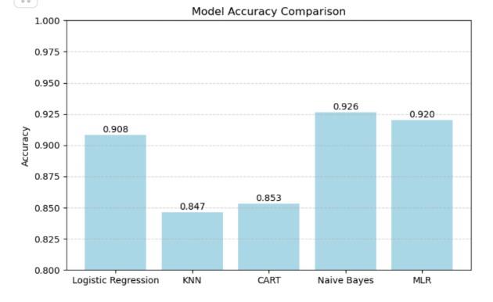
OVERALL MODEL PERFORMANCE COMPARISON
  Multinomial Naïve Bayes achieved the highest accuracy (92.6%).
  Logistic Regression and Multiple Linear Regression performed competitively.
  KNN showed the weakest performance due to high-dimensional TF-IDF features.
  Naïve Bayes works well for sparse text because it models term frequencies effectively.

Slide 15
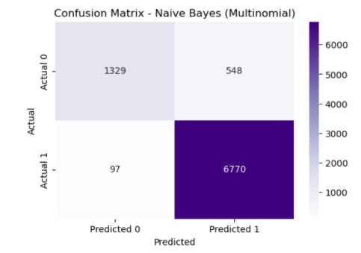
BEST MODEL PERFORMANCE: MULTINOMIAL NAÏVE BAYES
  High true positives and true negatives indicate strong model reliability.
  Very few misclassifications across both classes.
  Demonstrates effective generalization on unseen text.
  Best suited for text-based sentiment classification.

Slide 16
  Multinomial Naïve Bayes achieved the best performance for sentiment classification.
  Logistic Regression and MLR performed well, while KNN and Decision Tree showed lower accuracy.
  TF-IDF with normalization and PCA provided an effective preprocessing pipeline.
  Excluding neutral reviews simplified the task but may limit real-world generalization.
  Future work: explore word embeddings, transformers, and multiclass sentiment analysis.
CONCLUSION

Slide 17
Thank You

